Slide 1
Data Analysis
Heat Exchanger Price Prediction
using Machine Learning

Slide 2
ABOUT THE PROJECT
Predicting the Price of new product. Current procedure of evaluating the price of a particular product tales abut two months. We are trying here to develop machine Learning Model that will minimize the timeline to close the Request for Quotation (RFQ) and provide internal targets to respective departments.

Slide 3
DEPLOYING DATA MODEL
EVALUATION OF OPTIMISED MODEL
MODEL OPTIMISATION THROUGH FEATURE SCALING
EVALUATION OF THE MODEL
ALGORITM SELECTION
PRAPARING DATA TO BIILD DATA MODEL
FEATURE SELECTION
EXPLORATORY DATA ANALYSIS
DATA PREPARATION

Slide 4
96.8%
Domestic Market Share
70 %
Commercial Vehicle Business

Slide 5
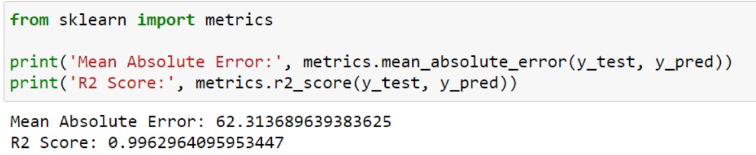
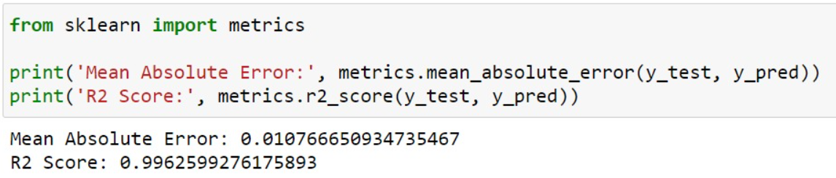
Model Performance
Before Optimization
After Optimization

Slide 6
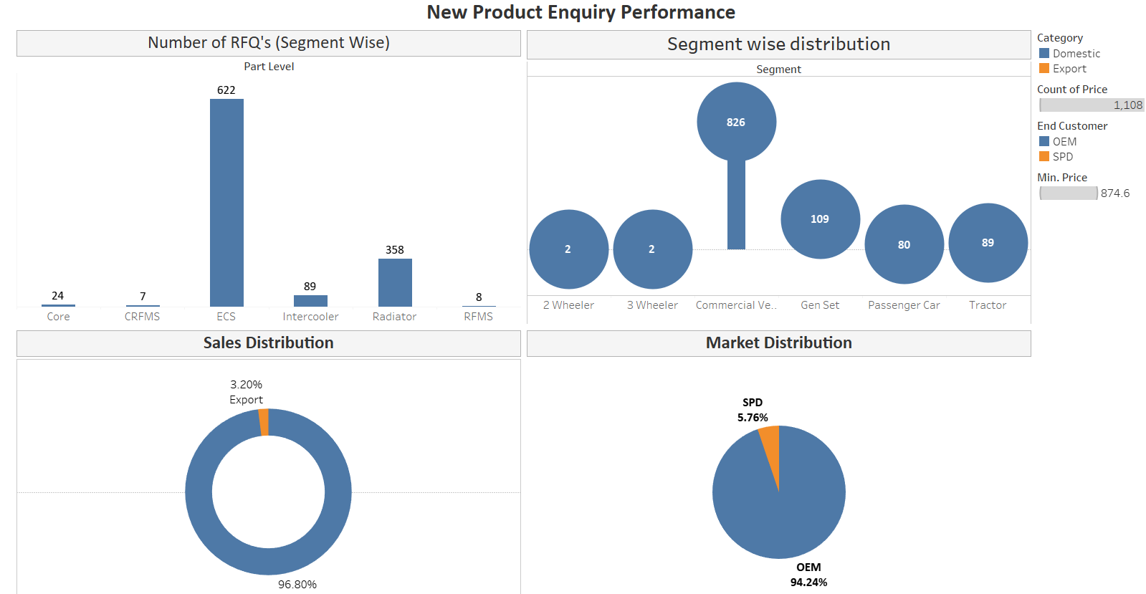
Dashboard

Slide 7
CONCLUSION
Hence, we infer that post model deployment, we would save company recourses in terms of manpower that would help to increase the efficiency.
Bridging the Gap between Supplier and Purchaser by elimination dependency on multiple stakeholders involved during Price Determination evaluation.
Predefined target based on the predicted price by the model to respective stakeholders to ensure maximized profit per part.

